Slide 1
LESSON 5
BOOK CHAPTER 24
ELECTRIC POTENTIAL

Slide 2
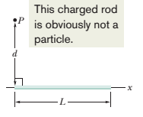
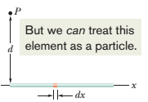
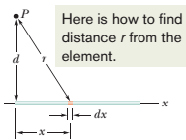
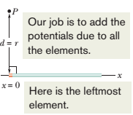
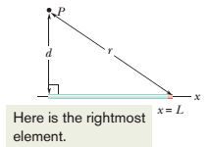
Potential due to a Line of Charge:
A thin nonconducting rod of length L has a positive charge of uniform linear density λ. Let us determine the electric potential V due to the rod at point P, a perpendicular distance d from the left end of the rod.

Slide 3
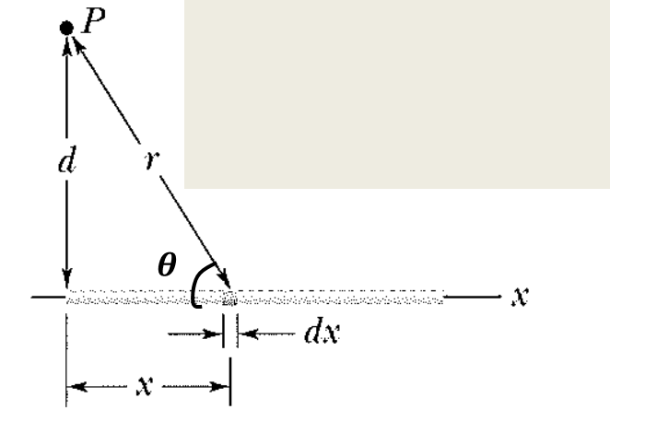
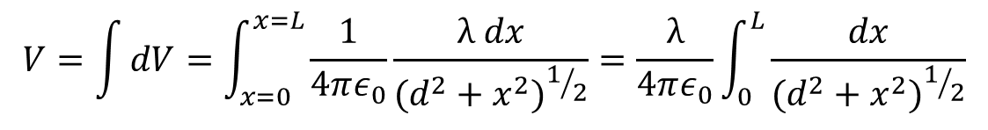
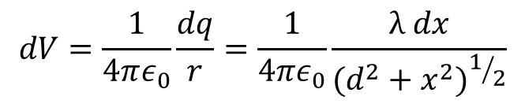
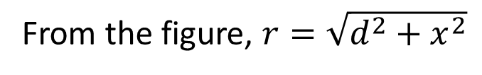
Potential due to a Line of Charge:
Answer:
We consider a differential element dx of the rod as shown in the adjacent figure. This element of the rod has a differential charge,
dq = λ dx.
From the figure, $r=\sqrt{d^{2}+x^{2}}$
Treating the element as a point charge, the potential dV at point is
$$dV=\frac{1}{4πε_{0}}\frac{dq}{r}=\frac{1}{4πε_{0}}\frac{λ dx}{{(d^{2}+x^{2})}^{1/2}}$$
The total potential V produced by the rod at point P by integrating the above equation along the length of the rod, from x = 0 to x = L
$$V=\int{dV}=\int_{x=0}^{x=L}{\frac{1}{4πε_{0}}\frac{λ dx}{{(d^{2}+x^{2})}^{1/2}}=\frac{λ}{4πε_{0}}\int_{0}^{L}{\frac{dx}{{(d^{2}+x^{2})}^{1/2}}}}$$

Slide 4
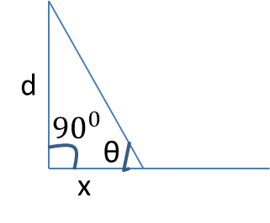

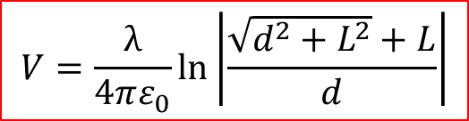

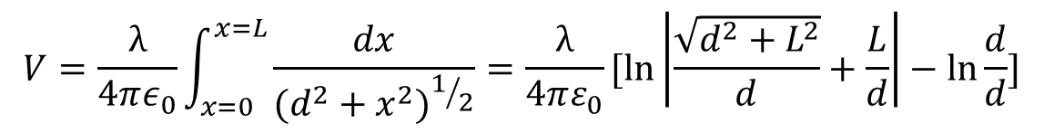
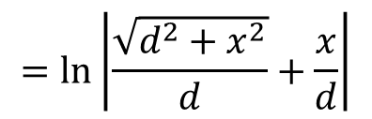
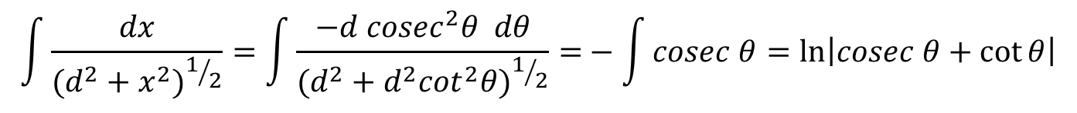

Let $\tan{θ=\frac{d}{x} and x=d\cot{θ}}$
$$\sqrt{d^{2}+x^{2}}$$
$$dx=−d {cosec}^{2}θ dθ$$
$$\int{\frac{dx}{{(d^{2}+x^{2})}^{1/2}}=\int{\frac{−d {cosec}^{2}θ dθ}{({d^{2}+d^{2}\cot^{2}θ)}^{1/2}}=}}−\int{cosec θ=\ln\left|cosec θ+\cot{θ}\right|}$$
$$=\ln\left|\frac{\sqrt{d^{2}+x^{2}}}{d}+\frac{x}{d}\right|$$
Now
$$V=\frac{λ}{4πε_{0}}\int_{x=0}^{x=L}{\frac{dx}{{(d^{2}+x^{2})}^{1/2}}}=\frac{λ}{4πε_{0}}[\ln\left|\frac{\sqrt{d^{2}+L^{2}}}{d}+\frac{L}{d}\right|−\ln{\frac{d}{d}]}$$
$$V=\frac{λ}{4πε_{0}}ln\left|\frac{\sqrt{d^{2}+L^{2}}+L}{d}\right|$$

Slide 5
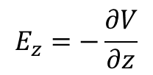
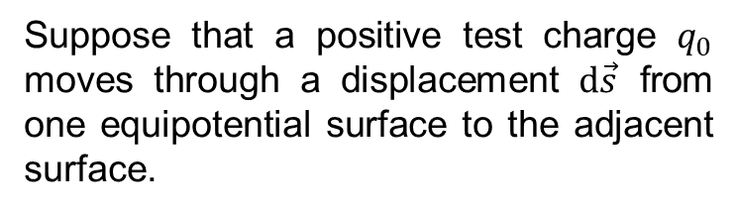




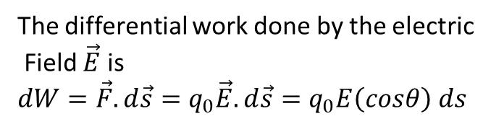
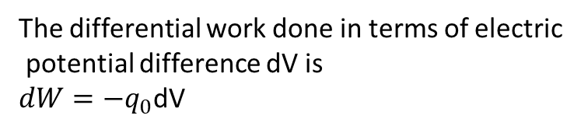
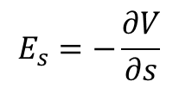
Calculating the Electric Field from the Electric Potential:
Suppose that a positive test charge $q_{0}$ moves through a displacement $d\vec{s}$ from one equipotential surface to the adjacent surface.
The differential work done in terms of electric
potential difference dV is
$dW=−q_{0}$dV
The differential work done by the electric
Field $\vec{E}$ is
$dW={\vec{F}.d\vec{s}=q}_{0}{\vec{E}.d\vec{s}=q}_{0}E\left(cosθ\right) ds$
Hence, we get
$−q_{0}dV=q_{0}E\left(cosθ\right) ds$
$E\left(cosθ\right)=−\frac{dV}{ds}$
$Since Ecos θ is the component of \vec{E}$ in the direction of $d\vec{s}$ , then
$$E_{s}=−\frac{∂V}{∂s}$$
If we take the s axis to be, in turn, the x, y, and z axes, we find that the x, y, and
z components of $\vec{E}$at any point are
$$E_{x}=−\frac{∂V}{∂x} ;$$
$E_{y}=−\frac{∂V}{∂y}$ ;
$$E_{z}=−\frac{∂V}{∂z}$$

Slide 6
Thank You

